Slide 1
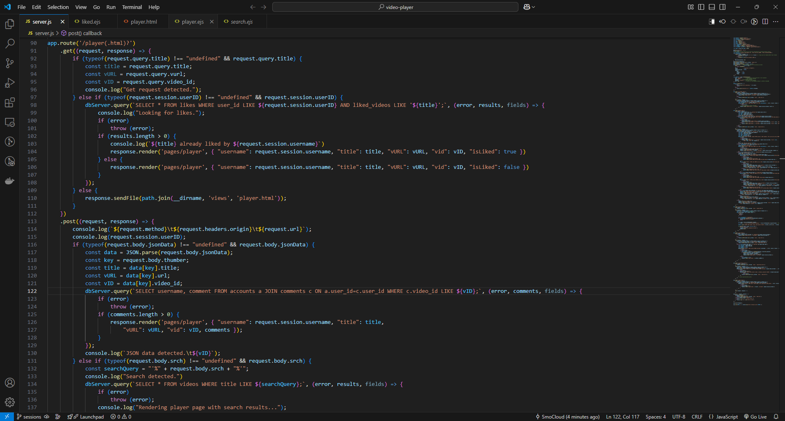
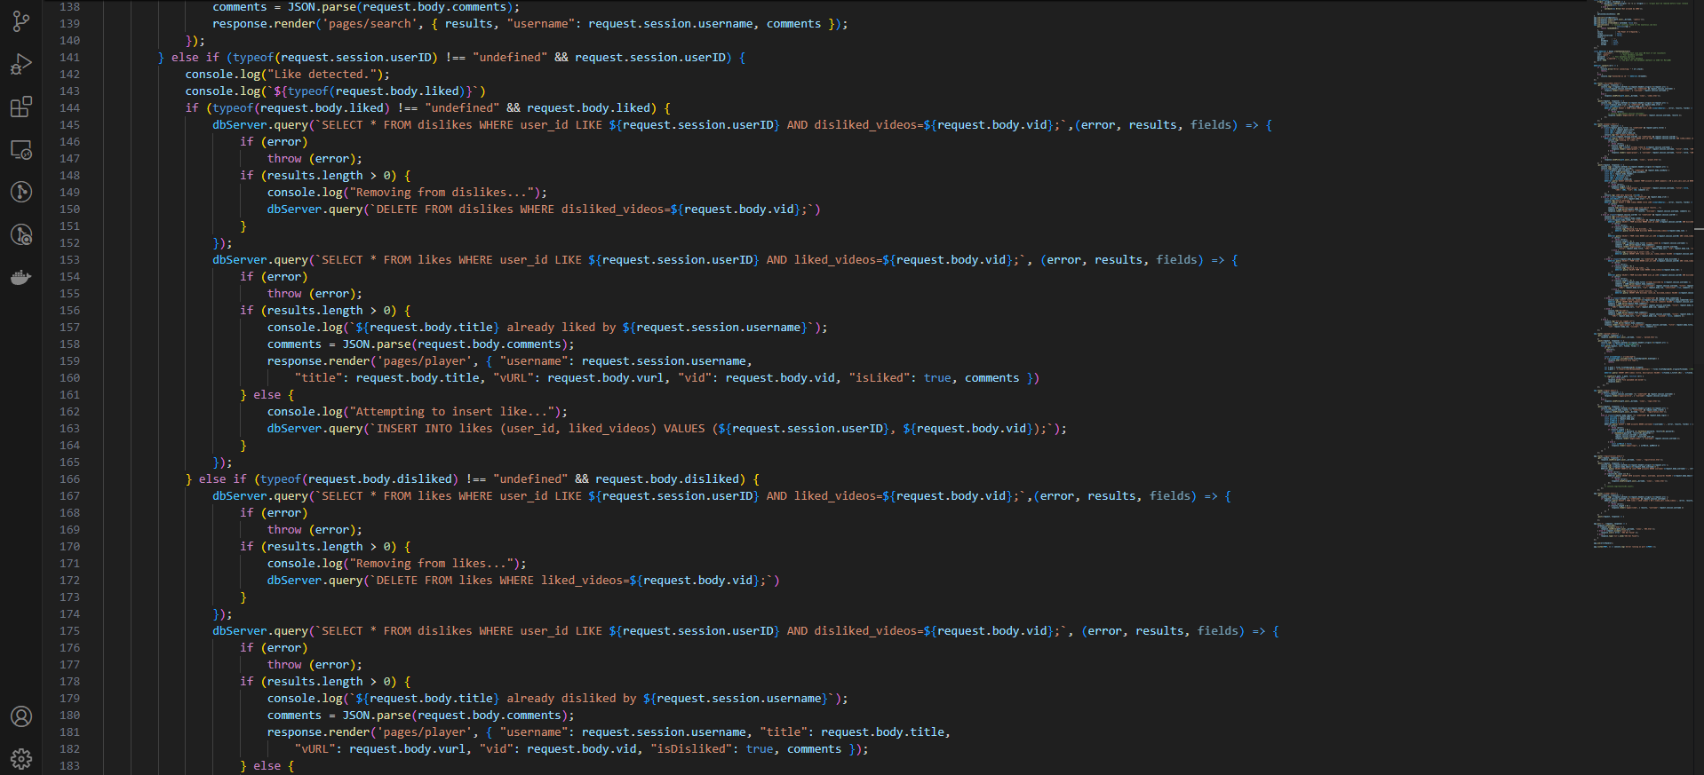
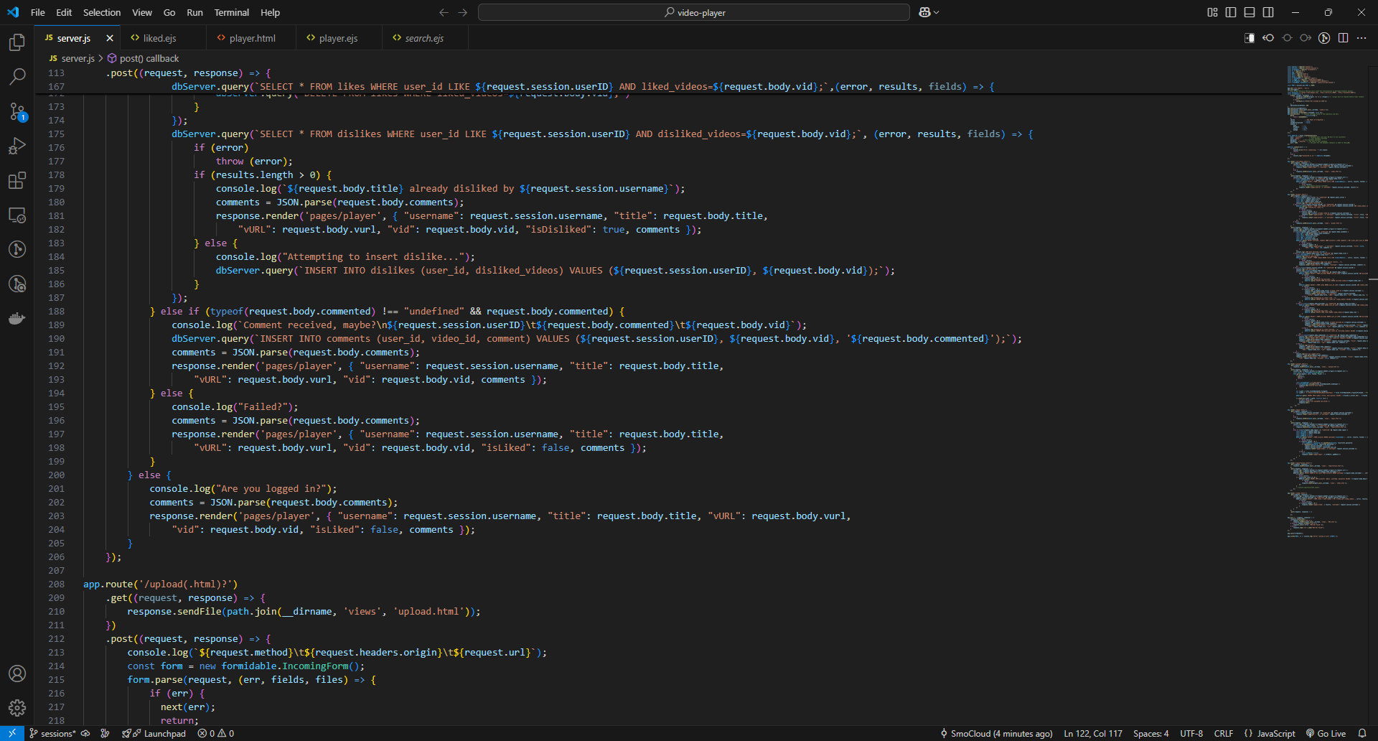
Database & Server Changes
New Tables
Likes table tracks who’s liked what video(s)
Dislikes table tracks who’s dislikes what video(s)
Comments table tracks who’s commented on what.
New interactions
Session retains login between pages
Can like/dislike videos
Likes and dislikes mutually exclusive
Can view all liked videos through liked videos tab
Videos display in the player with their comments
Future Goals
Fully integrate comments on frontend
Redesign tables to be more scalable:
Each account has their own likes/dislikes table
Each video has their own comments table
Set up database and node server on a cloud machine
Biggest Challenge
There’s a lot of data being passed back and forth between the front-end and back-end and making sure that the data is what you expect is tricky.

